Slide 1
Data Analytics on Large Scale Call-Log Dataset
ABHISHEK GARAI
CARNEGIE MELLON UNIVERSITY

Slide 2
SCENARIO
Problem Statement
Acme Wireless Company is PROCESSING DATA FROM CELL TOWERS recorded in a binary format and STORING THIS IN A DATA STORE FOR ANALYSIS on call quality (dropped calls), call durations, data usage, and marketing campaigns. It currently takes 3 days from call to report and the business wants a more agile solution that takes less than 1 day.
Solution ??

Slide 3
Representative Plot Interpretation
Initial Concerns
Call-Logs Substantial Amount of Data Big-Data problem
Format Needs to be pre-processed for Analytics
Schema design Format of storage should aid Analytics
Reports Simple, Insightful and User-friendly
Logs
Contains Relevant and Peripheral Data
Reason To equip for better analytics which may not be evident
E.g. Session download/upload Amount for different call types
Used to measure the efficiency/quality of network data transfer
Format
Data captured might be in coarse format with missing and incorrect values
Not all the data collected would be in the same format
E.g. Shorter calls might be measured in seconds whereas long duration calls might be measured in minutes/hours
The parameters like session durations and upload/downloads may be recorded incorrectly

Slide 4
Representative Plot Interpretation Continued…
Design
Schema Design Consistent across all types of records whether it is a voice, video, web call etc.
Avoid storing redundant data across multiple tables
Normalization and Efficient Utilization of storage and efficient data management
Design choice of MySQL/NoSQL database should be based on the analytics requirements and type of data captured
E.g. A Data-warehouse should be typically installed on NoSQL DB Hbase
A Database where analytics are continuously performed and queried should be typically implemented in MySQL.
Reports
Should be pertinent and related to the data being analysed
Should be simple and easy to understand and straightforward
Visual representation preferred over tabular representation
E.g. Shown later

Slide 5
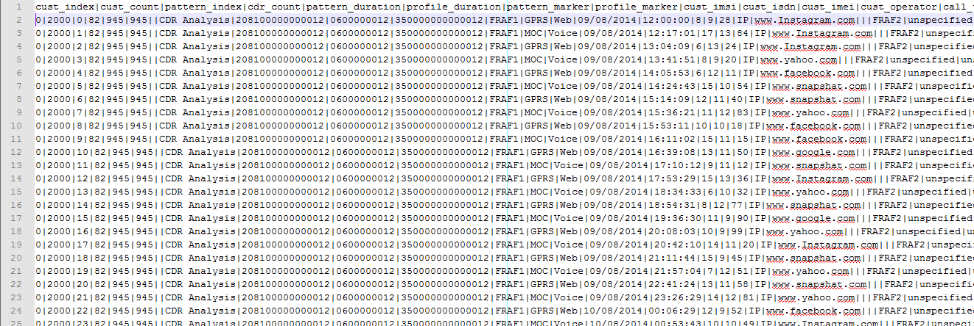
Snapshot Of The Raw Dataset

Slide 6
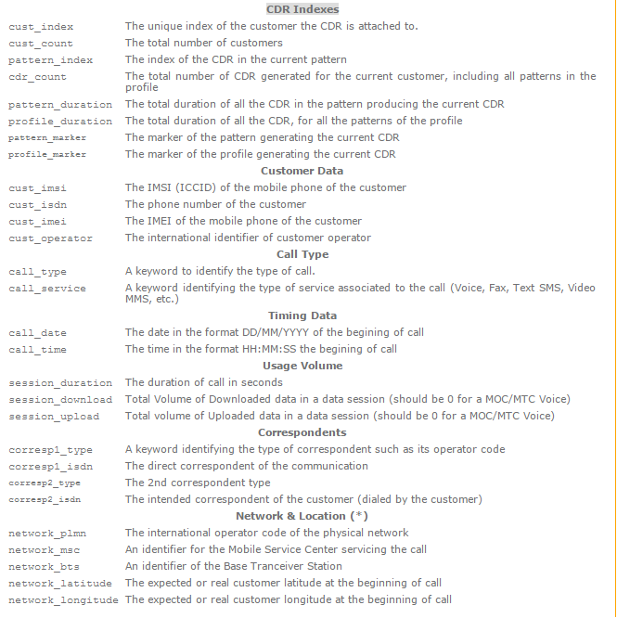
Raw Data Columns

Slide 7
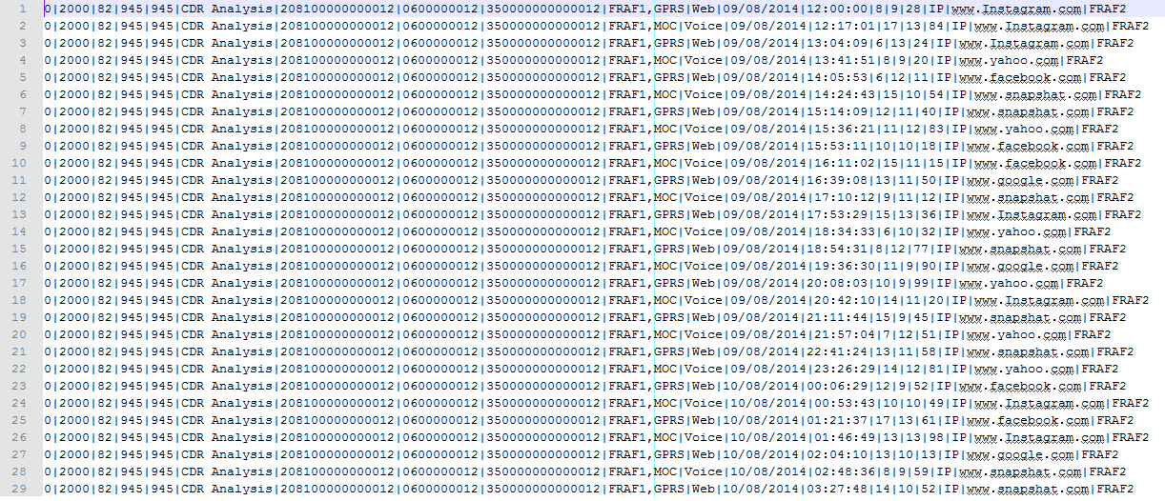
Snapshot Of The Pre-processed Data

Slide 8
Solution Architecture

Slide 9
Assumptions
These were the few assumptions that were made during the designing of the solution approach
The call-logs are received daily at the EOD similar to batch but the duration is very short i.e. a single day
Architecture can be extended to actual streaming input dataset that is received continuously by the system
Certain columns containing null (blank) or garbage (unspecified) were filtered during the ETL phase
The data provided was sorted based on the cust_id
This may not be the case in streaming data
But, Map-Reduce Programming Model handles the situation as every line is independently processed

Slide 10
Input Dataset
SCHEMA DESIGN
Customer Schema (P.K.-cust_id)
Consists of customer details like cust_indx, cust_id,
cust_isdn, cust_imsi, cust_imei
This is the base table that connects the other schemas
Call_log Schema (F.K.-cust_id, crspndt_id, n/w_id)
Relevant details about a particular call between two customers i.e. call_time, call_date, call_duration etc.
Correspondents Schema (P.K.-crspndt_id)
Details of the correspondents/network operators like crspndt_id, crspndt_code, crspndt_isdn etc.
Network Schema(P.K.-n/w_id)
Details of the network parameters like physical_n/w_id,
physical_n/w_addr etc.

Slide 11
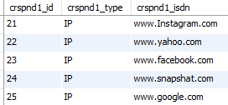

Snapshot
Schemas
Customer
Call_log
Correspondent Network_log

Slide 12
Normalization Of Data
To avoid redundant storage of repetitive data
E.g. customer details for every call record
We normalize the tables in the backend and join them using P.K., F.K. relationship
This also aids in efficient maintenance of data w.r.t. updation and deletion.
E.g. New correspondent-record/customer-record can be added without actually having a log associated with the user
Updates can be done independently without affecting the call log records
Tables joined using P.K., F.K. mappings

Slide 13
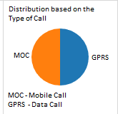
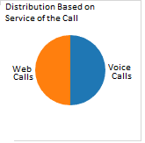
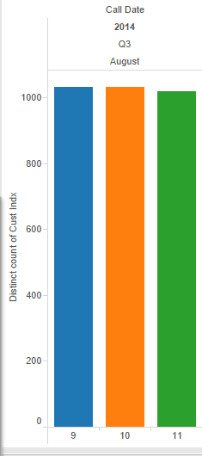
Visualization – Complete Dataset
Tableau was utilised to perform the necessary visualizations
This aids better interpretation of the analytics performed
Easier decision making through trend-analysis of graph plots
Facilitates a naïve user to make sense of the data captured

Slide 14
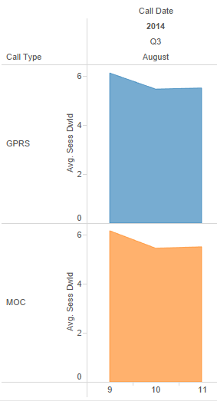
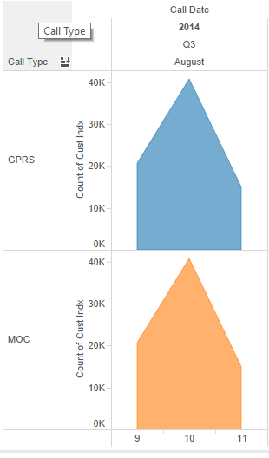
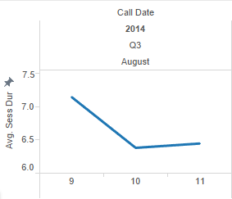
Visualizations Continued…
Another fact I was concerned
about was to keep track
of the usage by the customers.
Track Usage
To detect any kind of attacks
or possible exploitation of services

Slide 15
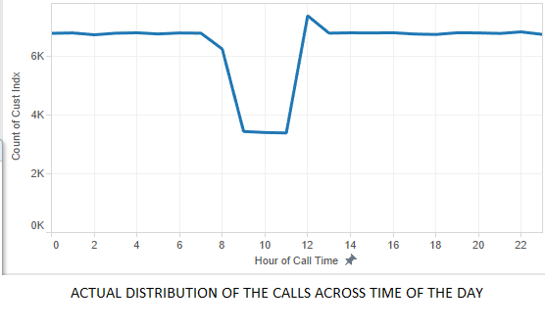
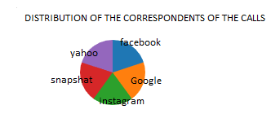
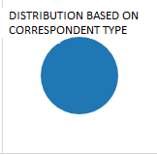
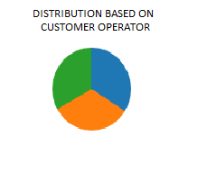
Visualizations Continued…
The Call-Log was for Voice-over IP/Video over IP calls. So, distribution based on correspondent type is obviously as below

Slide 16
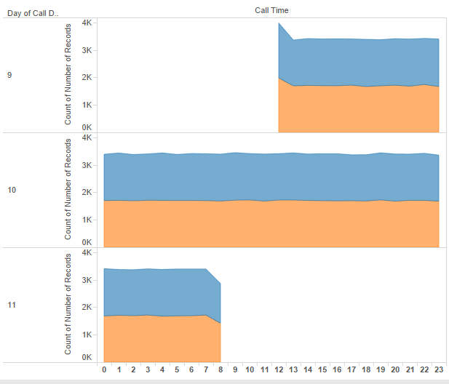
Scope Of The Dataset …

Slide 17
Conclusions
Aug 9th ‘14 – Saturday – Avg. Call Dur. – 7.15 mins
Aug 10th ‘14 – Sunday– Avg. Call Dur. – 6.35 mins
Aug 11th ‘14 – Monday– Avg. Call Dur. – 7.42 mins
People seems to be talking longer on Saturdays than Sundays which is reasonable. Also, Avg. dur. on Mondays are higher may be due to the start of the week.
There are more people making calls on Sundays as compared to Saturdays & Mondays
Dataset Scope was from Saturday evening to Monday morning.
The actual number of calls made drops significantly between 9 am – 11 am which may be due to the fact that people might be travelling for their work-places and hence might not be making calls.
Subsequently, the number of calls immediately increases significantly with a spike indicating that calls are made to receive the latest updates.

Slide 18
Dropped Calls Records Logs & Assumptions
Call Duration Analysis
MAX Duration: 599 secs. (Outlier – 1 record)
Second MAX Duration: 451 secs (Outlier – 1 record)
Third MAX Duration: 375 secs (Outlier – 1 record)
Fourth MAX Duration: 353 secs (Outlier – 1 record)
All the way upto 107 secs considered as outliers.
Most of the calls are between 2-15 secs which can be considered as dropped. Calls above 30 secs can be considered to be reasonable.
Visualizations based on the above assumptions
Next Slide

Slide 19
Considering Dropped Calls Data
Call Duration | Number of Calls | %
1 sec | 11 | 0.007
2-15 secs | 145654 | 95.35
16-30 secs | 5549 | 3.63
31-106 secs | 1482 | 0.97
107-599 secs | 61 | 0.03
Date | Avg Duration | Avg Duration
9th Aug | 51.6222 | 6.386
10th Aug | 48.1587 | 6.0383
11th Aug | 47.0325 | 6.0834
Avg. Sess. Dur: 49.4763 secs
% Dropped Calls: 98.98

Slide 20
Dropped Call Analysis – Performance Analysis
Correspondent | Dropped Calls | Complete Calls | % Dropped Calls | % Complete Calls
Instagram | 30211 | 315 | 19.99708758 | 18.75
Yahoo | 30207 | 335 | 19.99443992 | 19.94047619
Facebook | 30049 | 354 | 19.88985749 | 21.07142857
Snapshat | 30308 | 335 | 20.06129325 | 19.94047619
Google | 30302 | 341 | 20.05732176 | 20.29761905
Date | % Dropped Calls
9th | 98.27
10th | 99.15
11th | 99.07
Total Dropped Calls : 151077
Total Complete Calls: 1680

Slide 21
ROAD-BLOCKS
Comprehending the Expectations
Approach of performing the Analytics
Extraction-Transformation-Load (ETL)
EMR Cluster Single Node Local Mapper & Reducer
Dataset Size
Out of Memory issues while pre-processing locally
Configuring appropriate cache and heap memory required
Storage for Analytics
Excel MySQL-RDBMS (Also, certain NoSQL Approach)
Data Visualization
Comprehending the best approach for representing the results to naïve audience
Minitab Excel Tableau

Slide 22
Code Snippets
DEMO

Slide 23
Questions Thank You

